Slide 1

Groenpunt
Integration Project I
Karel de Grote Hogeschool

Slide 2
Table of contents
Who am I & What did I do
Sales pitch
Demo Web & Android
Conclusions
Analysis burndown chart
Analysis timesheet
Retrospective

Slide 3
Who am I & What did I do
Niels Van Steen
Who am I
INF203A
Project manager & software architect
What did I do
Authentication & Authorization
Front-End, UI design with CSS
Other features e.g., statistics, tags, pagination, ..

Slide 4
Who am I & What did I do
Sander Verheyen
Who am I
INF203A
Quality Management & User experience
What did I do
Moderation for the comments
Comment section
Others e.g. editing sales pitch, helping with app design, …

Slide 5
Who am I & What did I do
Michiel Verschueren
Who am I
INF203B
Testing
What did I do
Doc-Review Write page
Import Doc-Review
Project Settings

Slide 6
Who am I & What did I do
Bjorn Straetemans
Who am I
INF203A
Android developer
What did I do
Android app
Backend for the app
Testing of the web application

Slide 7
Who am I & What did I do
Brian Nys
Who am I
ISB204
Deployment
What did I do
Google Cloud research
Bash scripting, python scripting
Google Cloud integration in .NET

Slide 8

Sales pitch

Slide 9
Demo Web & Android
Web
https://docreview-groenpunt.be/admin/Account/Login
Android
See demo

Slide 10
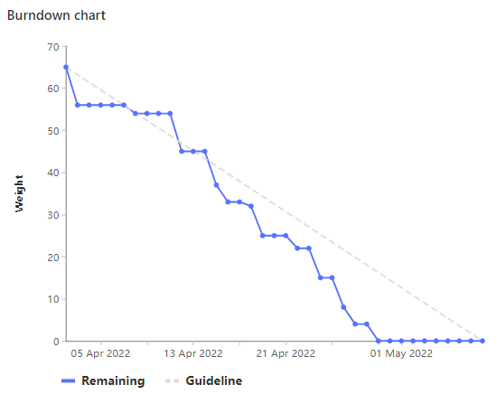
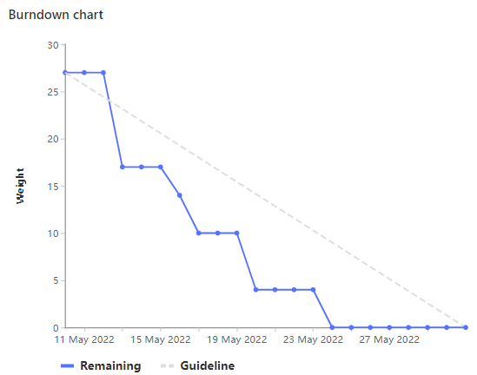
Conclusion - Burndown charts
SPRINT 1 SPRINT 2

Slide 11
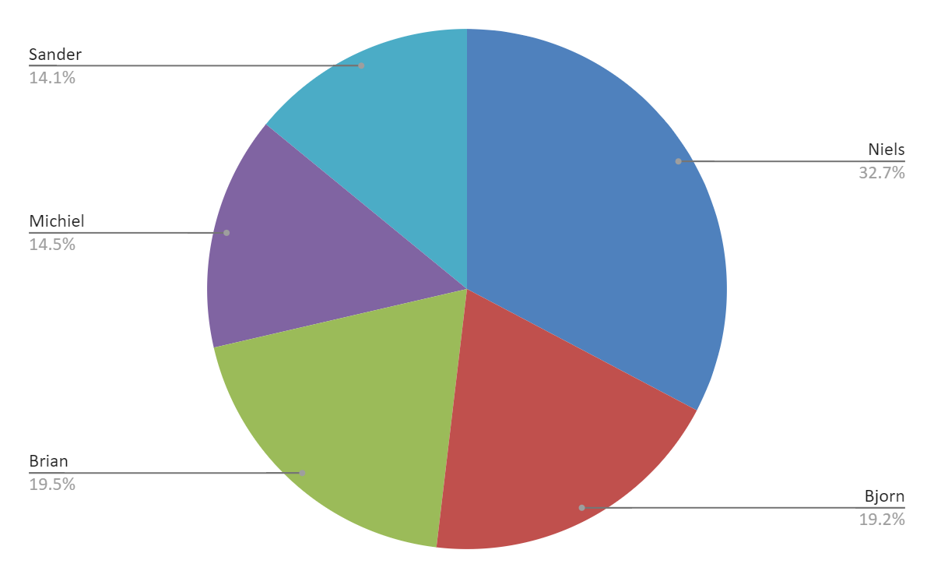
Conclusion - Analysis timesheet
Total issue weight | 158
Total hours | 1314
Actual hours / issue weight | 8.3
Planned hours / issue weight | 2

Slide 12
Conclusion - Analysis timesheet
Overestimated | Bringing all story points together
Underestimated | Total hours per issue weight Specific technical aspects

Slide 13
Conclusion - Retrospective
What went excellent?
Dividing the tasks & responsibilities
Pleasant ambiance
What needs improvement?
Communication
Disagreements

Slide 14
Thank you for your attention!
Questions?

